Slide 1
CSC1004 Tutorial 7 Yan KE

Slide 2
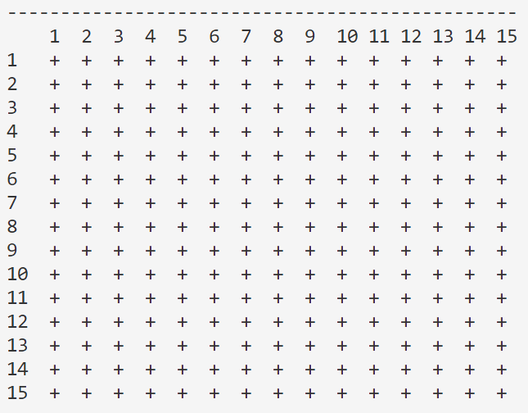
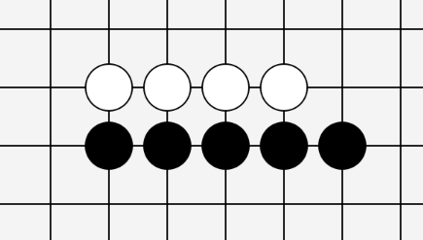
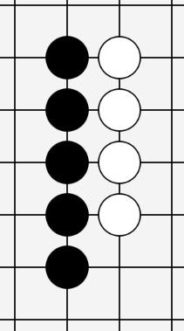
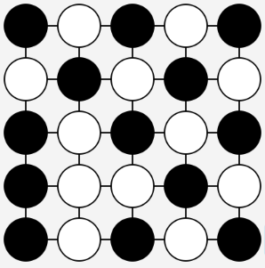
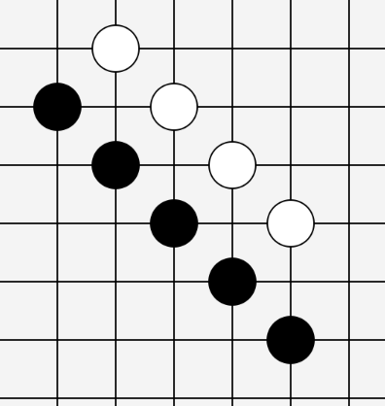
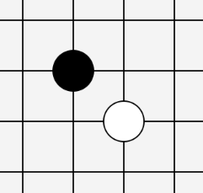
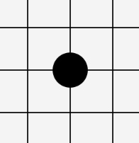
Gomoku Game (Recall)
Game Over
15×15 Chess Board
One Player Wins (Black in This Example)
A Draw (No One Wins)
(e.g. we
suppose
the board
is scaled
down
to be
5×5)
Horizontally
All positions for stones (chess)
are taken without reaching
the winning condition.
Black Plays First
Player 1, place first
No Overlap
vertically
Already Placed
It’s not allowed
to place a stone
on some existing
stone.
(Also, it’s not allowed
to place any stone
If the game is over)
Player 2,
place later
Five stones in a line
Gomo
(and the stones should be placed on the intersection of the lines of the board)
diagonally
五目

Slide 3
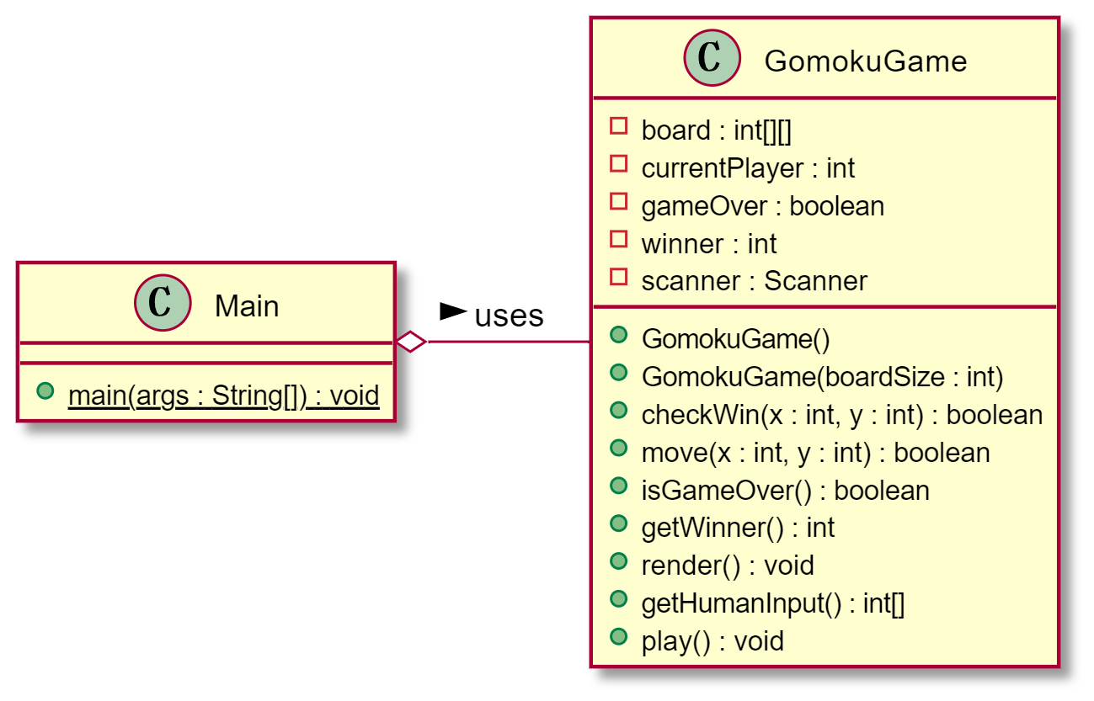
Class Design & Control Flow (Recall)
Class GomokuGame
Change to JavaFX starter
The main() function of Main class holds one instance
The instance of `GomokuGameFX` holds one instance of `GomokuGame`
Constructor()
Call the play() function to start the loop
The While loop in the play() function
gameOver?
implicit
via Event Listener
Yes
No
render()
via Mouse Event
(MouseClick Here)
x,y = hunmanInput()
> Show the result
> Close input flow
move(x,y)
Use JavaFX to render it
(render it outside)
Use checkWin() to modify gameOver
Handled by
Event Listener
(Implicit while loop)
From “console input”
To “mouse event”

Slide 4
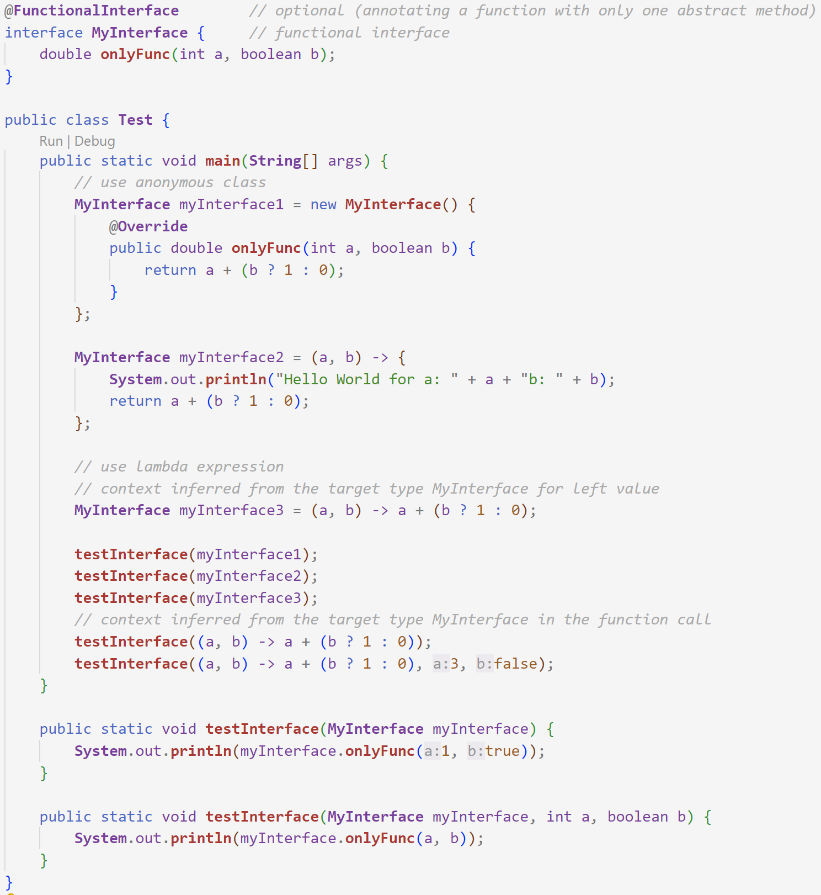
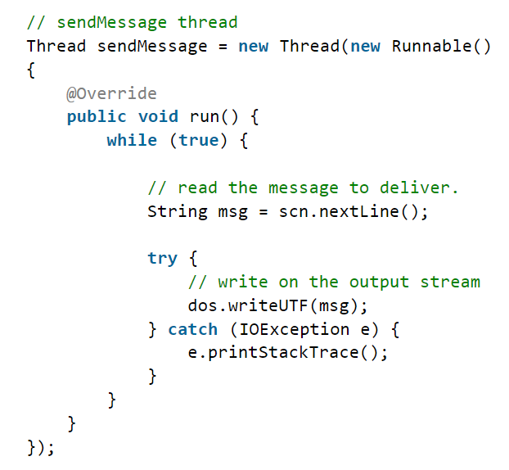
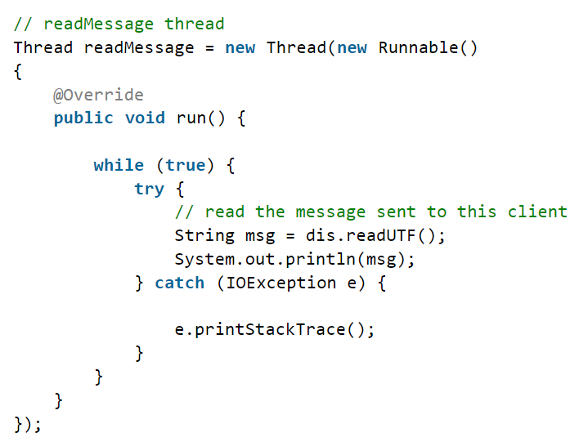
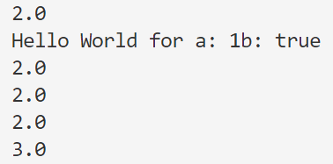
Lambda Expression
A brief glance
A small task: try to rewrite project 1 using lambda expression?
Output after running the code
Lambda expression is some syntactic sugar for anonymous initialization of some functional interface implementation
A functional interface should be of one and only one abstract method
The type of the target class and the type(s) of the argument(s) for the only overridden function is inferred from the context
Such context could be the lvalue or the function call, without ambiguity.

Slide 5
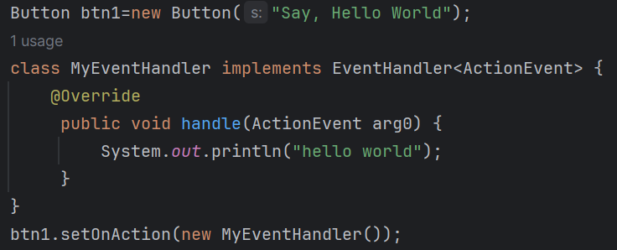
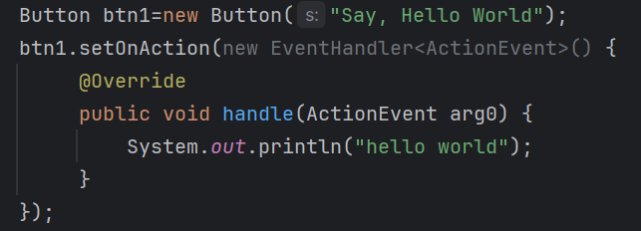


Lambda Expression
Using Instructor’s code as an example
Some explicit local class `MyEventHandler` is declared
The only overridden function is the `handle()` function
The argument type of the `handle()` function need to be explicitly provided
Some anonymous class is defined and initialized
The only overridden function is the `handle()` function
The argument type of the `handle()` function need to be explicitly provided
Statement lambda
The argument type of the `handle()` function is omitted
Write lines (and return statement) inside “{}”
Expression lambda
Only an expression is allowed, without “;”

Slide 6
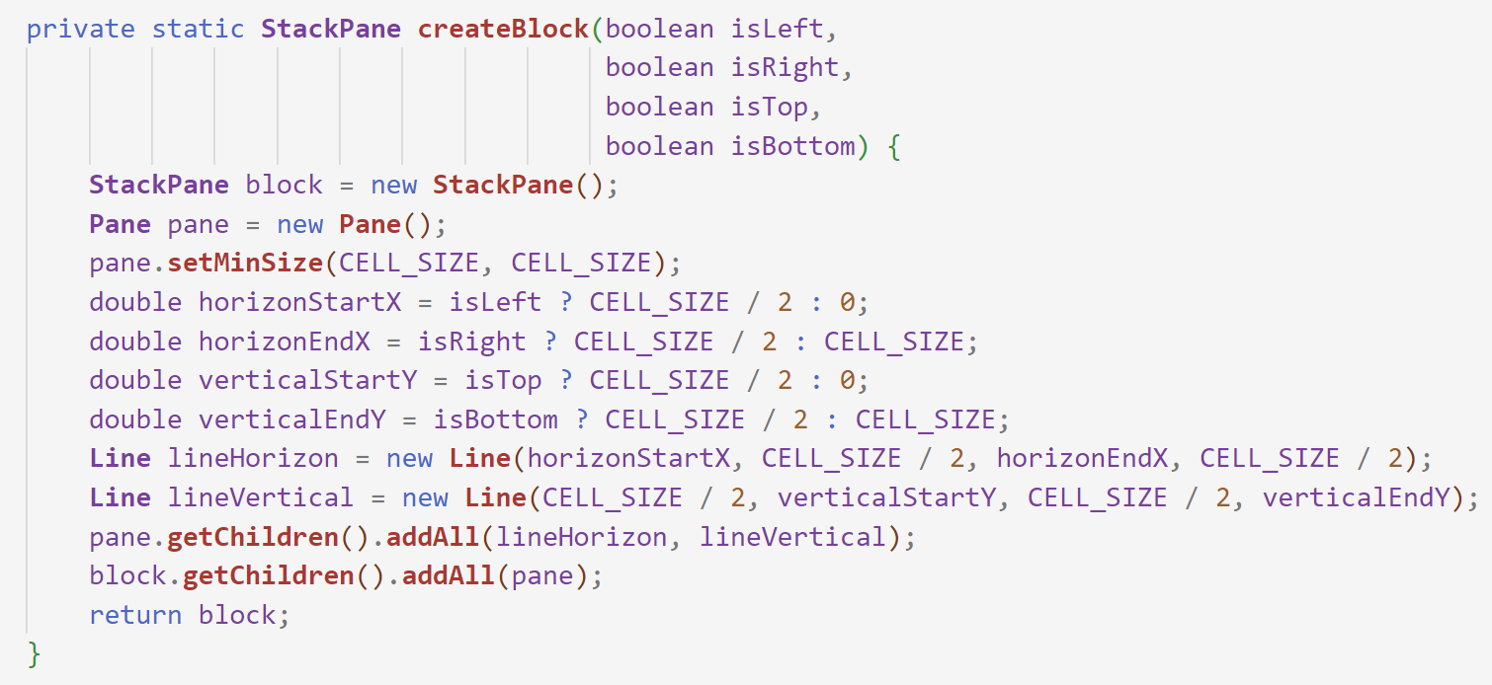
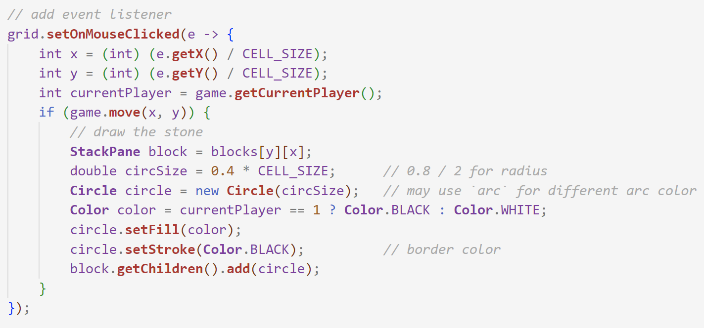
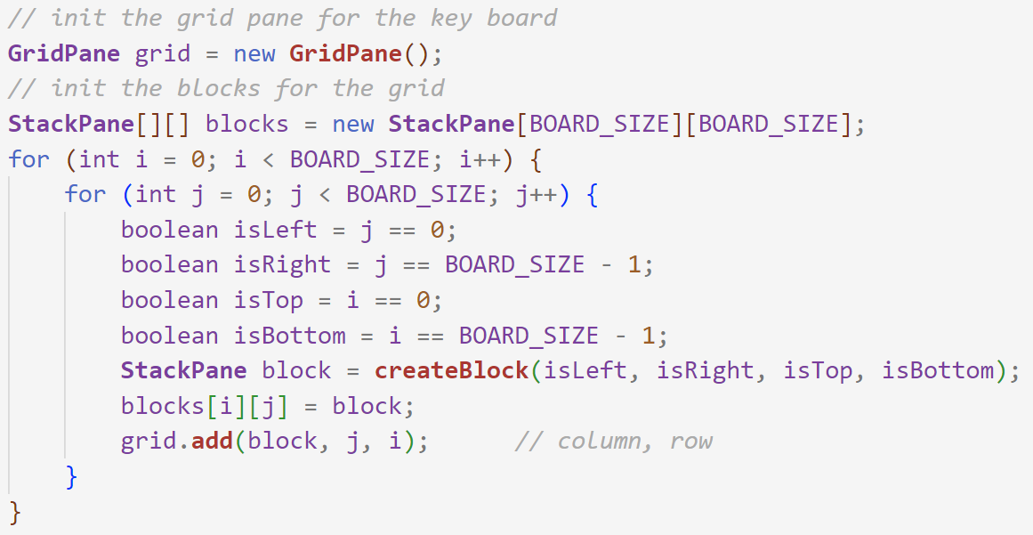
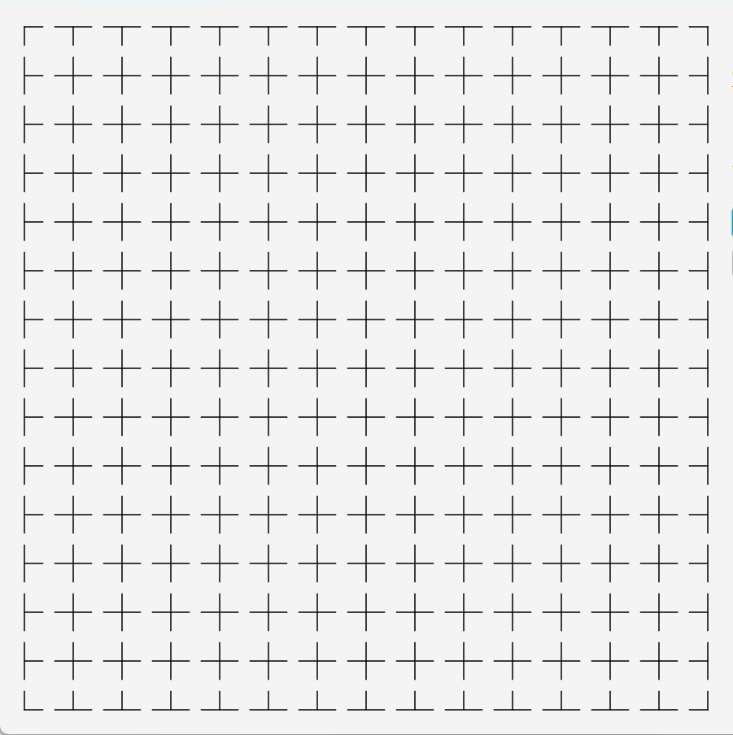
Rendering in JavaFX – via Layout
Each unit presents some “+” (except for the boundary & corners)
For the boundary or the corner, let the line start from the center of the unit
The horizontal line and the vertical line in each block is stored in a Pane instance rather than directly placed on the StackPane instance (why?)
Note that some blank space here is added to make it more obvious (will not appear with the code provided)

Slide 7
Rendering in JavaFX – via Layout
In JavaFX, when you're dealing with layout containers such as StackPane, the layout of child nodes is managed by the container itself, which includes their positioning. This means that properties like startX, startY, endX, and endY of a Line node will not directly control its position within a StackPane the way you might expect if you're trying to position the Line relative to the StackPane's top-left corner.
Instead, startX, startY, endX, and endY properties of a Line define the start and end points of the line relative to the line's own local coordinate system. When you add the line to a StackPane, the line will be centered in the StackPane by default, and its start and end points will be calculated from the center position where the line is placed, not from the StackPane's top-left corner.
We may check the size of a block’s children to see whether a stone is placed on:
If the size > 1, there is some stone on it
Remove element starting from 1 to remove the stone

Slide 8
Rendering in JavaFX – via Layout
Size of the StackPane instance (approximately):
Height = LineWidth
Width = CELLSIZE / 2
Add one vertical line:
Height = CELLSIZE / 2
Width = CELLSIZE / 2
(A minimum closure for inner contents)
layoutX, layoutY = 0, 0
StackPane
StackPane
StackPane Instance’s
Pos.CENTER (Default)
Size: not yet set
Line
Line
Line
Auto Shrinking
for Size not Specified
startX = CELLSIZE / 2
startY = CELLSIZE / 2
endX = CELLSIZE
endY = CELLSIZE
layoutX, layoutY = 0, 0
layoutX, layoutY = 0, 0
StackPane
Line
StackPane Instance’s
Pos.CENTER (Default)
setMinSize(CELL_SIZE, CELL_SIZE)
StackPane Instance’s
Pos.TOP_LEFT(Default)
setMinSize(CELL_SIZE, CELL_SIZE)
StackPane
Line
startX = CELLSIZE / 2
startY = CELLSIZE / 2
endX = CELLSIZE
endY = CELLSIZE
startX = CELLSIZE / 2
startY = CELLSIZE / 2
endX = CELLSIZE
endY = CELLSIZE

Slide 9
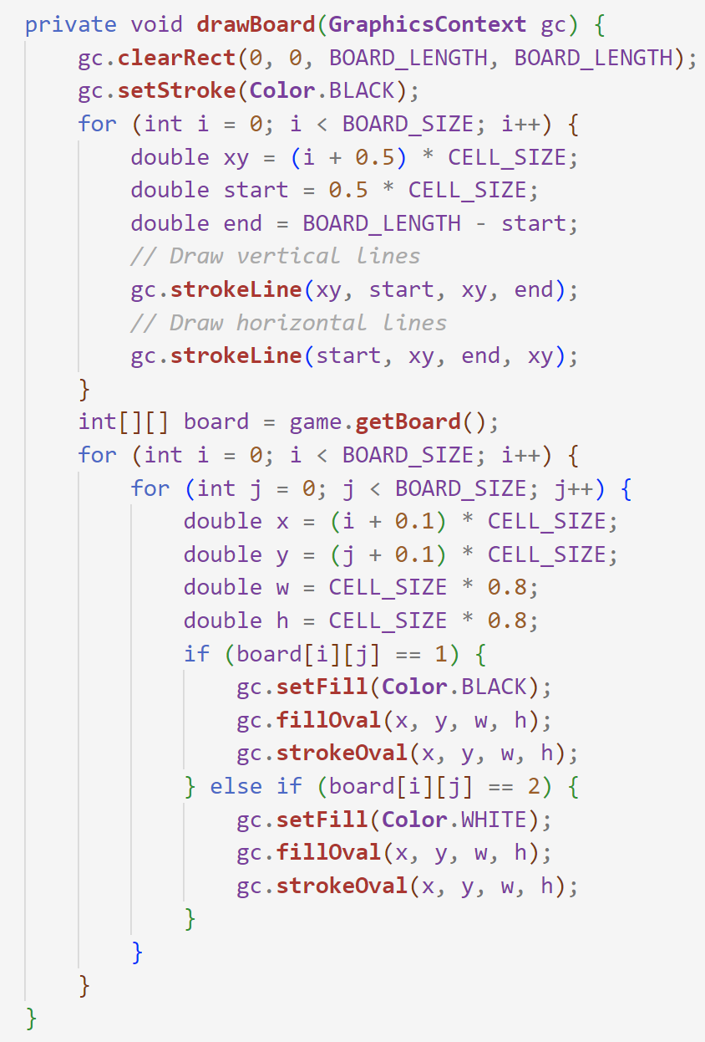
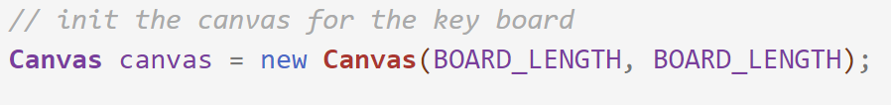
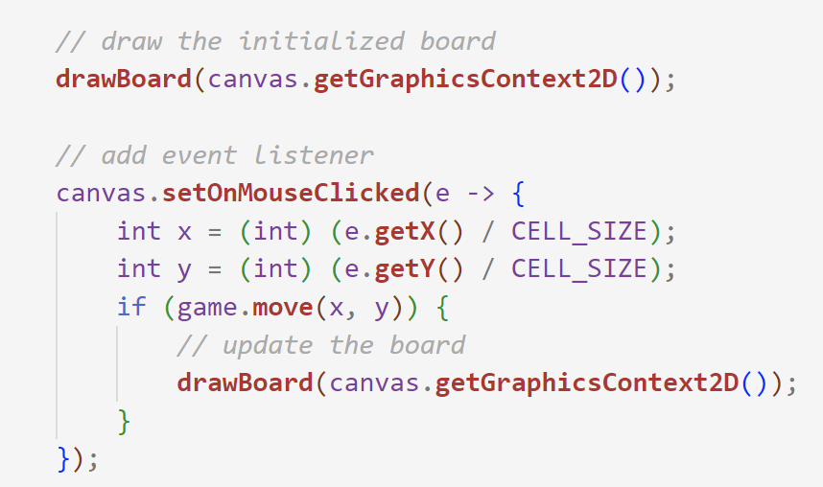
Rendering in JavaFX – via Canvas
Draw Horizontal Lines
Draw Vertical Lines
Only the canvas can provide `GraphicsContext2D`
May draw the line first and draw each stone in each move rather than redraw
However, redrawing is convenience when we reset the whole game
Chess Board Attained

Slide 10

THANK YOU
林天麟 教授
香港中文大学（深圳）
机器人与人工智能实验室
WeChat: tinlunlam

